Slide 1
SC1015 MINI PROJECT
Presented by:
Lab W132 | Group 3 Sivanesh Sampath (U2230059G) Joel Tham (U2230228E)

Slide 2
Table of contents
01
02
03
04
Introduction
Data Analysis
Domain - Football Industry
Cleaning and visualising the data
Machine Learning
Conclusion
Usage of AI Models to answer the question
What we learnt, our findings and insights

Slide 3
01
Introduction
The Football Industry

Slide 4
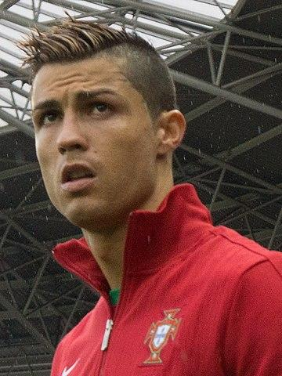
$3.2 Billion
Market Size of the Football Industry in 2022

Slide 5
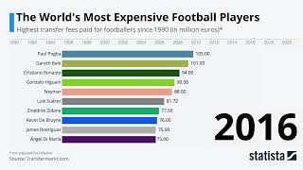
Ever Changing Market Value of Players

Slide 6
Goal

Slide 7
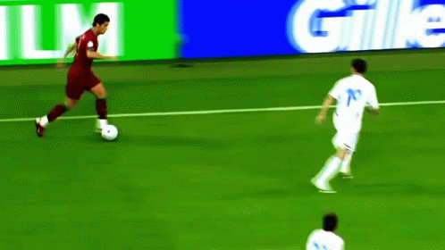
What is the most important variable in predicting market value of a player?

Slide 8





Age
Goals and Assists
Variables
Club Ranking
Position
Minutes Played

Slide 9
02
Data Analysis
Cleaning and visualising the data

Slide 10

Data Cleaning Pipeline
Remove Missing
Values
Remove Unnecessary Columns
Remove Outliers
Remove Symbols
Merge Relevant Variables

Slide 11

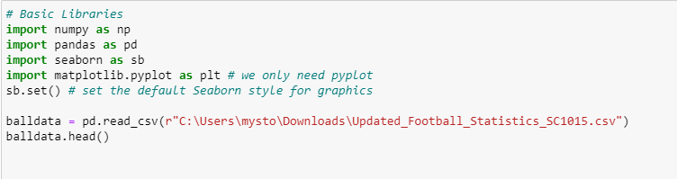
Sample Collection - Dataset
Raw data carefully chosen and accessed

Slide 12
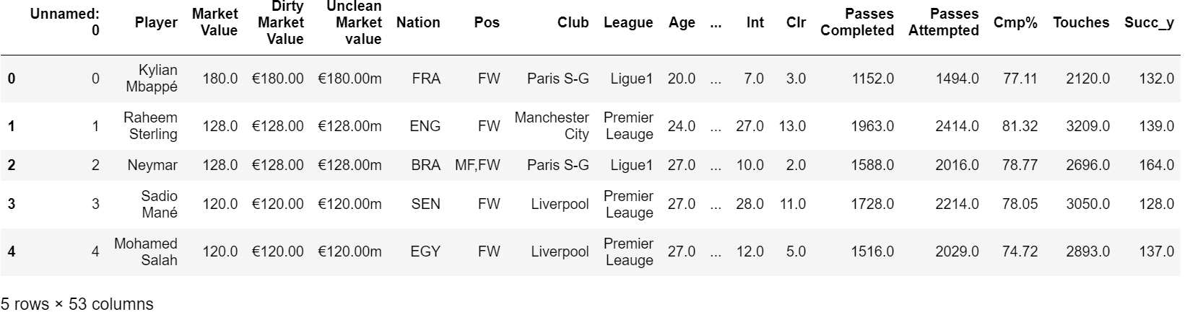
Dataset before cleaning

Slide 13
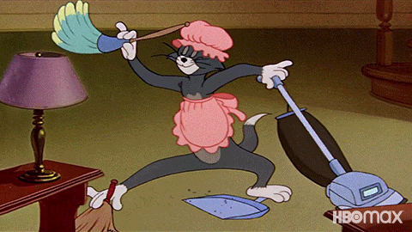
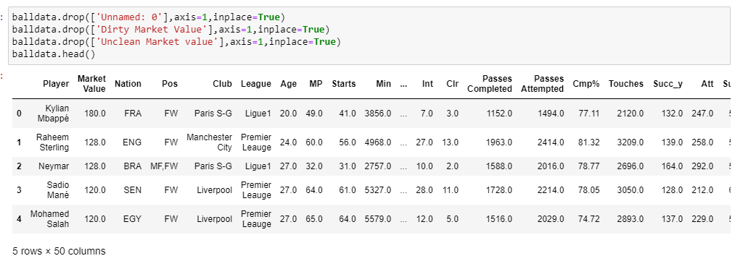
Dataset after cleaning

Slide 14
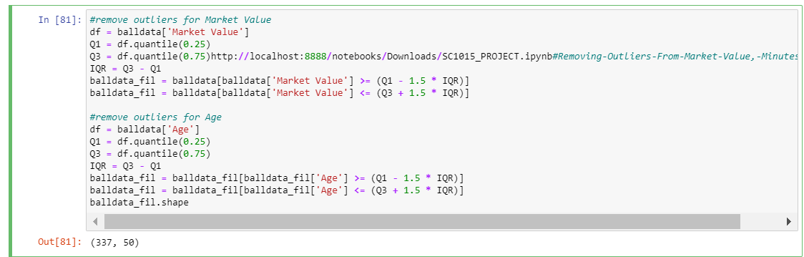
Removing Outliers From Data Set

Slide 15
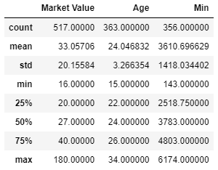
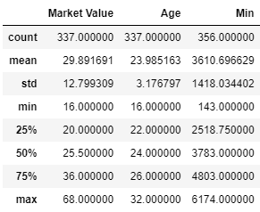
Removing Outliers From Data Set
Before Cleaning
After Cleaning

Slide 16
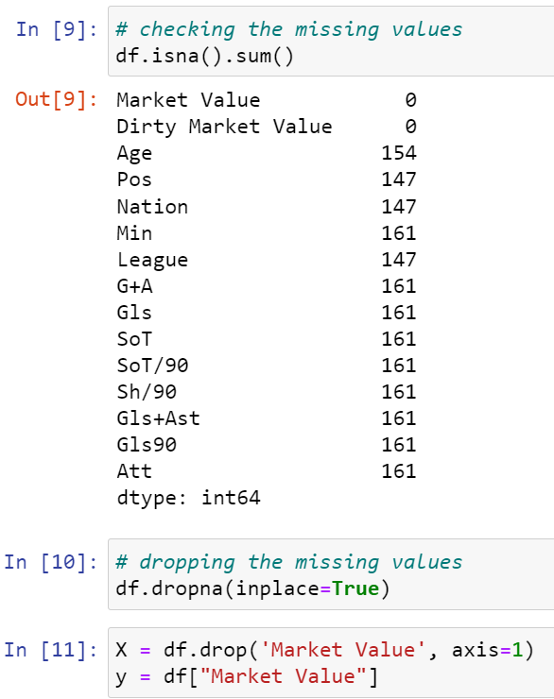
Checking and Removing Missing Values

Slide 17
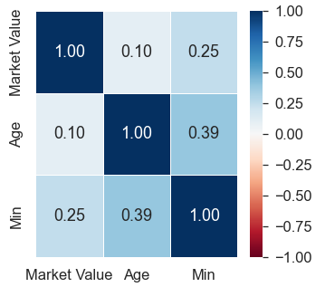
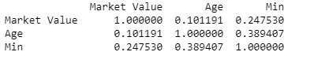
Data Visualisation
Numeric Variables - Age, Mins, Goals + Assists
Poor Linear correlation with Market Value!

Slide 18
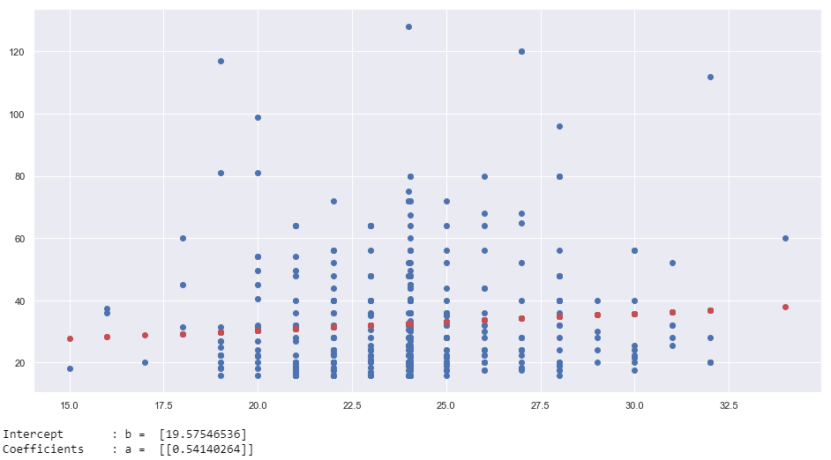
Data Visualisation
Predicting Market Value With Age
Correlation of Age with Market Value is 0.101191
Random scattering of points around linear regression line
Poor Linear Relationship

Slide 19
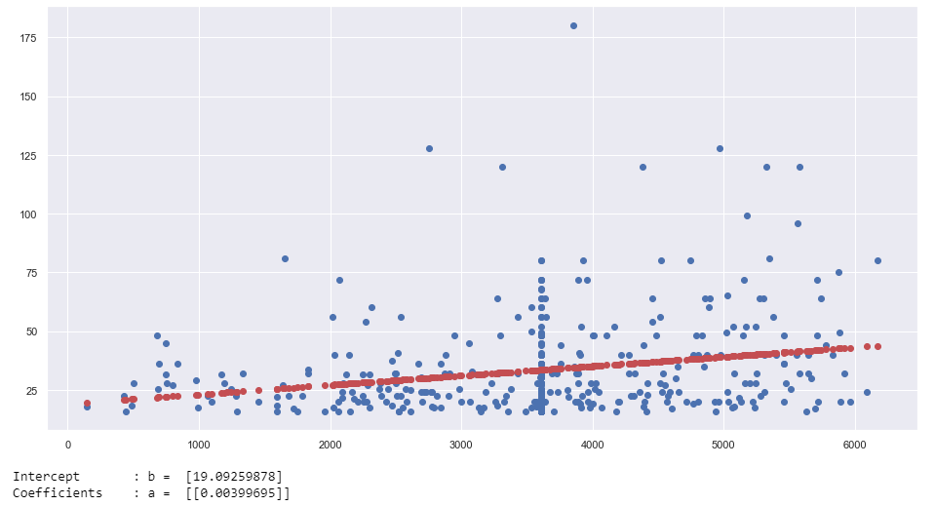
Data Visualisation
Predicting Market Value With Minutes Played
Correlation of Age with Market Value is 0.24753
Random scattering of points around linear regression line
Poor Linear Relationship

Slide 20
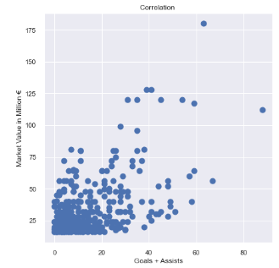
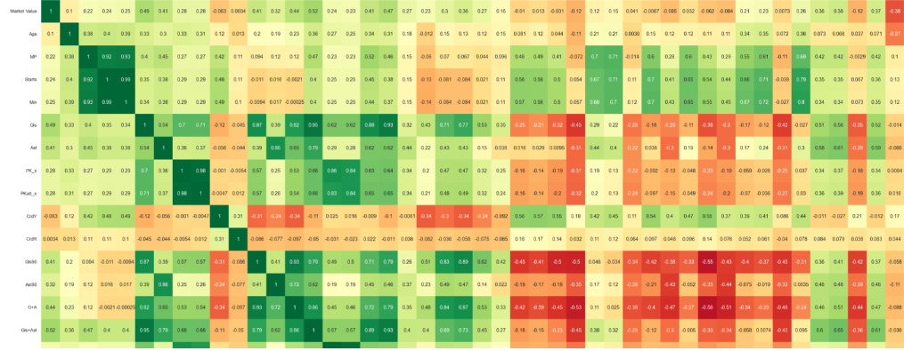
Data Visualisation
Predicting Market Value With Goal + Assists
Scatterplot found a moderate linear correlation of Goals + Assists with Market Value
Goal + Assists had the highest linear correlation with Market Value at 0.52
Moderate positive correlation

Slide 21
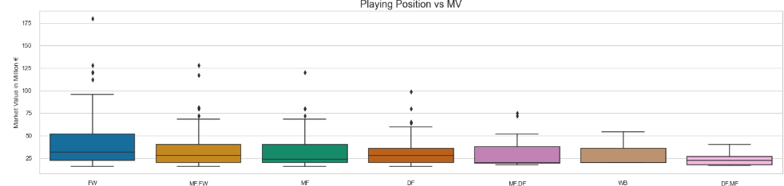
Data Visualisation
Predicting Market Value With Playing Position
Forwards had the highest median market value, followed by Defence then Midfield
Forwards had the largest Interquartile range
Forwards had the highest number of outliers in Market Value
Forwards generally have higher Market Value

Slide 22
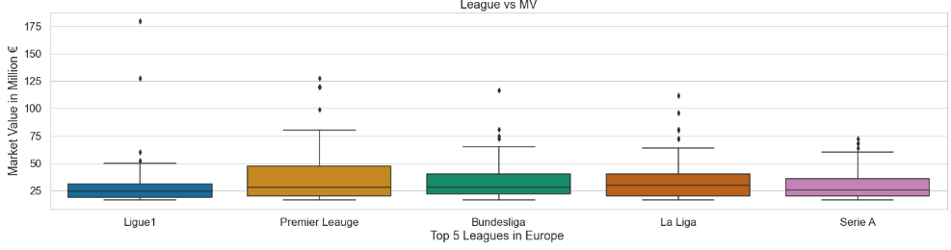
Data Visualisation
Predicting Market Value With Club Ranking
Players in LaLiga had the highest median Market Value
Players in Premier League had the highest IQR, many outliers
Players in Ligue 1 and Serie A had smallest IQR, least number of outliers
Players of different leagues have large differences in Market Value

Slide 23
03
Machine Learning
Usage of AI models

Slide 24


Random Forest
Decision Tree

Slide 25
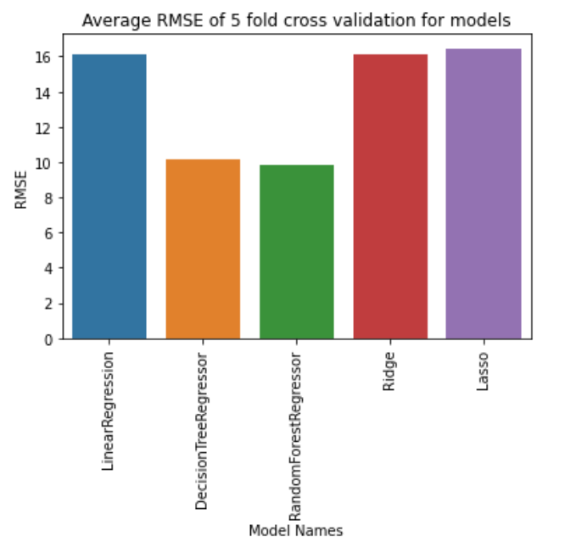
RMSE Root Mean Squared Error
Uses Euclidean Distance to measure quality of predictions
Measures Average Difference between ACTUAL and PREDICTED values
Random Forest Regression and Decision Tree Regression have the LOWEST RMSE !

Slide 26
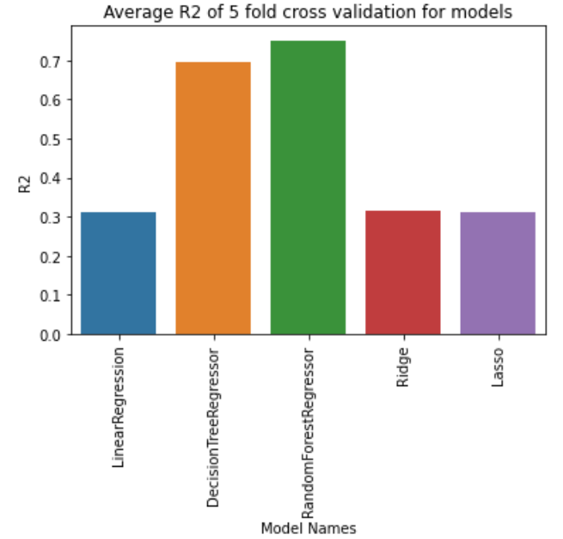
R2 R Squared ( Variance )
Measures how much a variation of a dependent variable is explained by an independent variable
Measures the goodness of fit of the models
Random Forest Regression and Decision Tree Regression have the HIGHEST R2 VALUES !

Slide 27
Usage of GridSearch Cross Validation
Technique used for finding the optimal parameter values from a given set of parameter values in a grid
Applied to both Random Forest Regression and Decision Tree Regression
Leads to more Accurate Predictions

Slide 28
Decision Tree
Uses a tree-like structure to predict a continuous target variable based on input features by recursively splitting the data.
The algorithm selects the feature that provides the most information gain at each split to determine how to partition the data.
Decision tree regression can make results more accurate by handling non-linear relationships, interactions between features, and missing values in the data, which allows it to capture complex patterns in the data that other algorithms may miss.

Slide 29
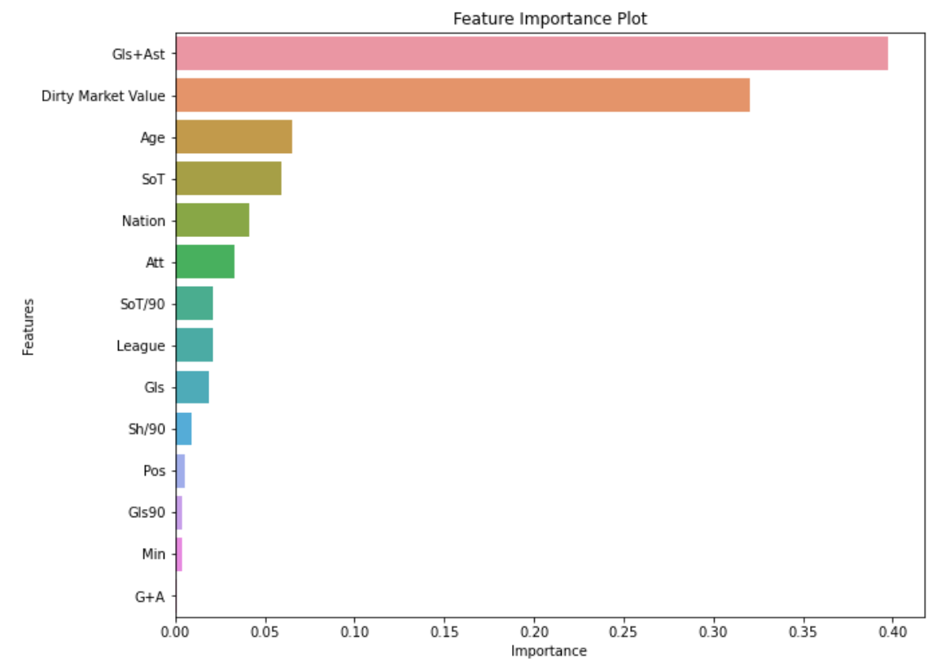
Decision Tree Feature Importance Plot
Measures the importance of each of the relevant features in predicting Market Value
Goals and assists is found to be the most important variable with an importance value of 0.38, followed by Age with an importance value of 0.07

Slide 30
Random Forest
Builds a Multitude of Decision Trees
Trees protect each other from their individual errors
Allows us to predict variables more effectively

Slide 31
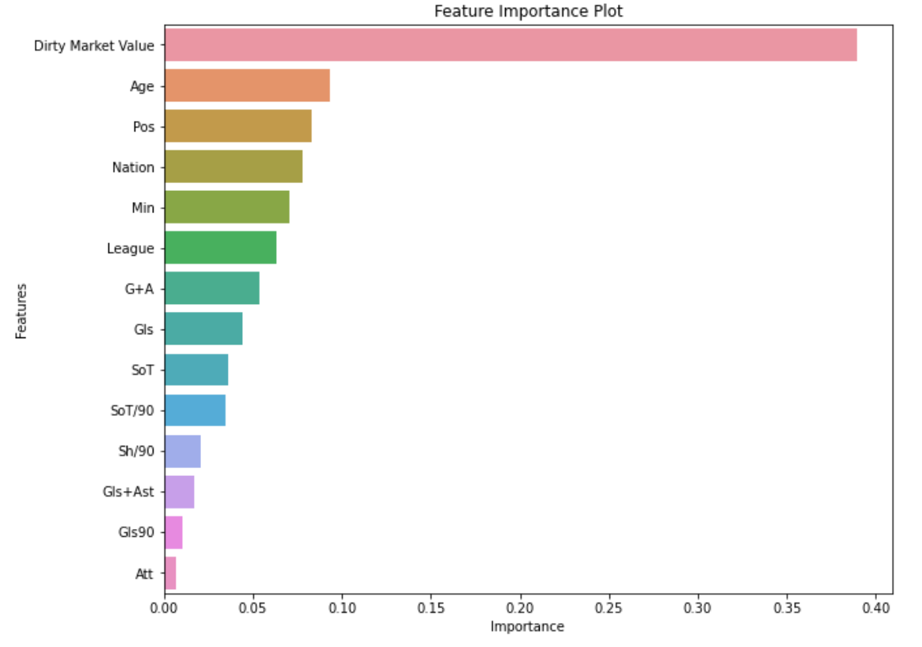
Random Forest Feature Importance Plot
Measures the importance of each of the relevant features in predicting Market Value
Age is found to be the most important variable with an importance value of 0.09

Slide 32
04
Conclusion
What we learnt,our findings and insights

Slide 33
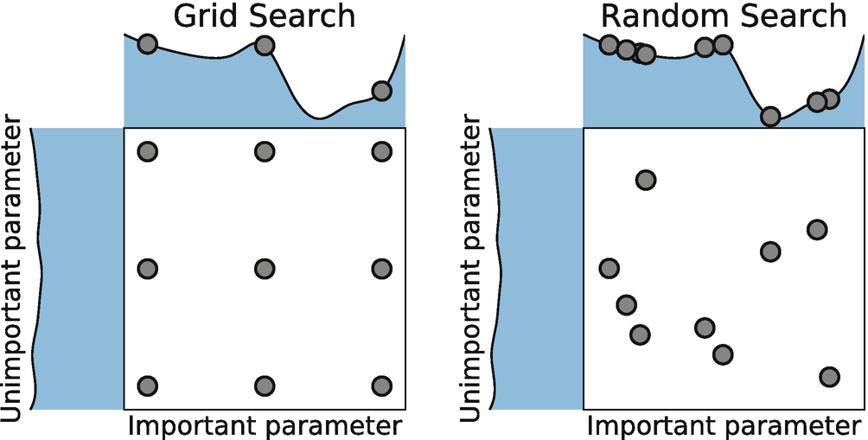
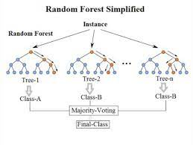
What have we learnt?
Applied Decision Tree Regression and Random Forest Regression on top of the standard Linear Regression to further enhance our predictions
Applied Cross Validation GridSearch to optimise our Machine Learning Models

Slide 34
Our Findings and Insights
Based on Random Forest, Decision Tree Regression
Age is the most important factor in determining Market Value of a player, followed by Goals + Assists
In general - a footballer’s prime is very closely linked to his/her age - affecting his Market Value
Decision Tree: Average R^2 Score: 0.695, Average RMSE Score: 10.136
Random Forest Regressor: Average R^2 Score: 0.748 ,Average RMSE Score: 9.181
Based On Linear Regression
Despite common belief that Market Value increases with Age
Age has a lack of positive correlation with Market Value (0.1012)
On the other hand, Goals + Assists had the highest linear correlation with Market Value (0.52)

Slide 35

Real World Application
With the introduction of AI in the football industry,
Analysts are better able to predict the Market Value of players
Factors such as Age, Goals + Assists which greatly influences a player’s market value should be considered seriously
It is notable that Non-numeric factors also affect the Market Value of a player
Positions such as Attacking Forwards tend to have higher Market Value
The Market Value of Players also converge & are similar in particular leagues
Analysts should consider all such factors to avoid overpaying an inflated price for football players and their transfer fees (a.k.a neymar 222 million euros)

Slide 36
Thank
You
Please keep this slide for attribution

Slide 37
List of references
Chauhan, N. S. (n.d.). Decision Tree Algorithm, Explained - KDnuggets. KDnuggets. https://www.kdnuggets.com/decision-tree-algorithm-explained.html
Football Market Size, Share, Trends | Industry Forecast 2023-2028. (n.d.). Football Market Size, Share, Trends | Industry Forecast 2023-2028. https://www.imarcgroup.com/football-market
R-Squared. (n.d.). Corporate Finance Institute. https://corporatefinanceinstitute.com/resources/data-science/r-squared/
Root Mean Square Error (RMSE). (n.d.). C3 AI. https://c3.ai/glossary/data-science/root-mean-square-error-rmse/
Yiu, T. (2021, September 29). Understanding Random Forest. Medium. https://towardsdatascience.com/understanding-random-forest-58381e0602d2

